Slide 1

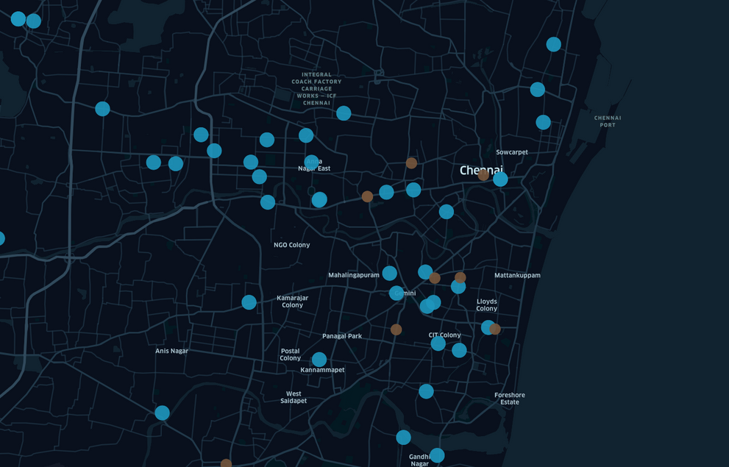
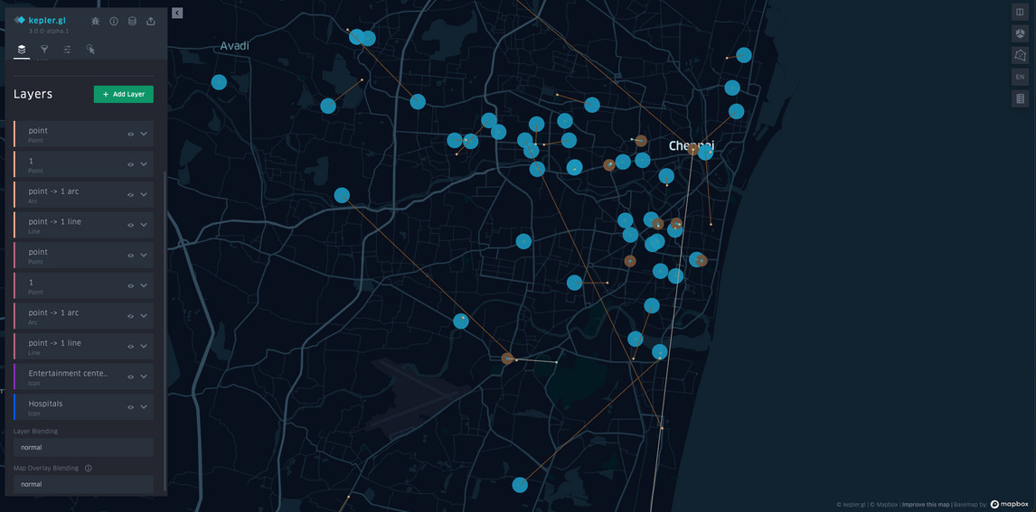
Spatial Data Analysis of Chennai's Tourist Destinations
Abstract: The project applies spatial data analysis to visualize tourist attractions in Chennai, aiming to enhance the utility of travel guides in everyday life.
Process: Data was digitized using OCR, geocoded to obtain latitude and longitude via Google Maps API, and tabulated for geo-visualization.
Objectives : Develop a visualization tool to recommend travel destinations and routes in Chennai.
Results: Maps with plotted tourist destinations reveal the spatial distribution of attractions.
‹#›

